Slide 1
PHP

Slide 2
PHP
PHP is a server side scripting language designed for web
development and also used as a general purpose programming
language
PHP is now installed on more than 24 crore websites and 21 lakh web
servers around the world
PHP was developed by Rasmus Lerdorf a member of the Apache
group in 1994
PHP originally stood for Personal Home Page and now PHP stands
for PHP: Hypertext Preprocessor
The first version of PHP version 1.0 was released in 1995
The latest version of PHP is version 7.1 released in December 2016

Slide 3
PHP
In a Webpage the PHP program starts with <?php and ends with a ?>
Any thing inside <?php ………………….…..?> is treated as PHP code
The PHP code is embedded in XHTML or HTML tags
A page which contains a php code should be saved with a .php
extension
PHP variables are not type declared and type of a variable is set
every time it is assigned a value
PHP supports both procedural and object oriented programming
PHP scripts are either embedded in XHTML documents or are in files
that are referenced by XHTML documents

Slide 4
PHP Syntactic Characteristics
All variable names in PHP begin with dollar signs ($) followed by a
letter or an underscore followed by any number of letters, digits or
underscores
PHP allows comments to be specified in three different ways # and //
are single line comments and /* and */ are multiple line comments
PHP statements are terminated with semicolons (;)
Braces are used to form compound statements for control structures
PHP variable names are case sensitive
The reserve words and function names in PHP are not case sensitive
There is no difference between while, WHILE, While and wHiLe
The following are the PHP reserved words

Slide 5
PHP reserved words
and | elseif | include | switch
break | extends | list | this
case | false | new | true
class | for | not | var
continue | foreach | or | virtual
default | function | require | xor
do | global | return | while
else | if | static

Slide 6
Variables
PHP has four scalar types and they are Boolean, integer, double and
string
PHP has also two compound types arrays and objects
As PHP is dynamically typed it has no type declarations and there is
no need to declare the type of a variable
The type of a variable is set when a value is assigned to it
A variable can be tested to determine if it currently has a value using
the IsSet function that takes a variable name as its parameter and
returns a Boolean value
eg. The IsSet($fruit) returns TRUE if $fruit currently has a non-NULL
value and FALSE otherwise

Slide 7
Variables
A variable can be set back to the unassigned state using unset
function
String Literals are defined with either single (‘) or double quotes (“)
In single quoted string literals escape sequences such as \n are not
recognized
In double quoted string literals escape sequences are recognized and
embedded variables are replaced by their current values
$sum = 10.2
“The sum is : $sum”
produces The sum is : 10.2

Slide 8
Boolean Type ,Arithmetic Operators and Expressions
The two possible values for boolean type are true and false which are
case insensitive
If an integer expression is used in Boolean context then it evaluates
to FALSE if it is zero otherwise it is TRUE
PHP has the usual collections of arithmetic operators +, -, *, /, %, ++
and -- with the usual meaning
If both operands are integers the result produced is also integer
If both operands are float the result produced is also float
If either of the operand is a double the result produced is double
In integer division even if both operands are integers the result
produced can be double

Slide 9
Predefined functions that operate on numeric values
Function | Parameter Type | Returns
floor | Double | Largest integer less than or equal to the parameter passed
ceil | Double | Smallest integer greater than or equal to the parameter
round | Double | Nearest integer
srand | Integer | Initialize a random number generator with the parameter
rand | Two numbers | A pseudorandom number greater than the first parameter and smaller than the second
abs | Number | Absolute value of the parameter
min | One or more numbers | Smallest
max | One or more numbers | Largest

Slide 10
String Operations
The main string operation is the concatenation operator specified
with a period (.)
String variables are treated like arrays to access individual
characters
The position of character starts with zero
eg. If $str has the value “apple” then $str{4} is e
The following table lists some of the most commonly used string
functions

Slide 11
Commonly used string functions
Function | Param Type | Returns
strlen | A string | The number of characters in the string
strcmp | Two strings | 0 if string1 = string2, -1 if string1 < string2, 1 if string1 > string2
strpos | Two strings | Returns the position of string2 in string1
substr | A string and an integer | Returns a substring of the main string starting from a specific location
chop | A string | All white space characters removed from end
trim | A string | All white space characters removed from both ends
ltrim | A string | white space characters removed from beginning
strtolower | A string | Uppercase letters converted to lowercase
strtoupper | A string | Lowercase letters converted to uppercase

Slide 12
Scalar Type Conversions
PHP has both implicit and explicit type conversions
Implicit type conversions are called coercions
If a numeric value appears in a string context the numeric value is
coerced to a string
If a string value appears in a numeric context the string value is
coerced to a numeric value
If a double is converted to an integer the fractional part is dropped
and rounding is not done
Explicit type conversions can be done like if the value of $sum is
4.777 the following produces 4
(int)$sum or intval($sum) or settype($sum, “integer”)

Slide 13
Output
The printf function is used to create output in PHP
The printf can be called with or without parentheses around its
parameters
Instead of a string parameter if some other type of value is given the
PHP interpreter will coerce it to a string
eg printf(47) will produce 47
PHP also has the printf function which is borrowed from C
The general format of printf is
printf(literal_string, param1, param2, …)
The format code uses a percent sign (%) followed by the field width
and a type specifier

Slide 14
Output
The common type specifiers are s for strings, d for integers and f for
floats and doubles
$day = “Monday” and $high = 79
printf(“The high on %6s was %2d”, $day, $high);
The following PHP program displays a welcome message and the
current day of the week, the month and day of the month
The date information is generated with date function
In the program l requests the day of the week, F requests the month,
j requests the day of the month and S next to j gets the correct
suffix for the day eg st or nd is used to create output in PHP

Slide 15
A PHP program to display date
<?xml version = "1.0" encoding = "utf-8"?>
<!DOCTYPE html PUBLIC "-//W3C//DTD XHTML 1.1//EN"
"http://www.w3.org/TR/xhtml11/DTD/xhtml11.dtd">
<html xmlns="http://www.w3.org/1999/xhtml">
<head>
<title>today.php</title>
</head>
<body>
<p>
<?php
print "<b>Welcome to my home page <br /> <br />";
print "Today is :</b>";
print date(“l, F jS");
print "<br />";
?>
</p>
</body>
</html>

Slide 16
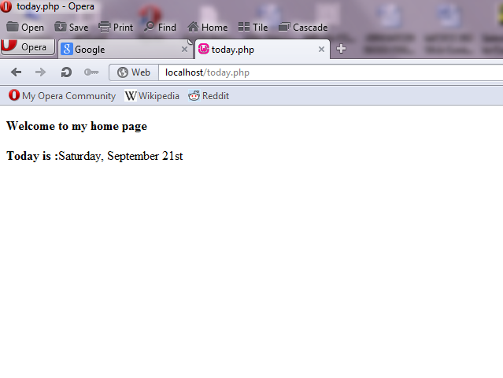
The Output of the program

Slide 17
Control Statements
The control statements of PHP are borrowed from C language
The relational operators of PHP are >, <, >=, <=, !=, and ==
There are two special operators === which produces TRUE only if
both operands are the same type and have the same values and
!== the opposite of ===
The Boolean Operators of PHP are or, xor, !, and, &&, ||
The and and && operator performs the same operation as or and ||
The selection statements if, elseif, case are also used in PHP
The loop statements in PHP are while, for , do-while and foreach
Break can be used in PHP to terminate the loop statements
The continue statement is also available in PHP

Slide 18
PHP programs to find the factorial
$fact = 1;
$count = 1;
while ($count < $n) {
$count++;
$fact *= $count;
}
for ($count = 1, $fact = 1; $count < $n;) {
$count++;
$fact *= $count;
}

Slide 19
A PHP program to display Powers table
<?xml version = "1.0" encoding = "utf-8"?>
<!DOCTYPE html PUBLIC "-//W3C//DTD XHTML 1.1//EN"
"http://www.w3.org/TR/xhtml11/DTD/xhtml11.dtd">
<html xmlns="http://www.w3.org/1999/xhtml">
<head>
<title>powers.php</title>
</head>
<body>
<table border = "border">
<caption> Powers table </caption>
<tr>
<th>Number </th>

Slide 20
A PHP program to display Powers table
<th>Square Root </th>
<th>Square </th>
<th>Cube </th>
<th>Quad </th>
</tr>
<?php
for ($number = 1; $number <= 10; $number++) {
$root = sqrt($number);
$square = pow($number,2);
$cube = pow($number,3);
$quad = pow($number,4);
print ("<tr align = 'center'> <td> $number </td>");

Slide 21
A PHP program to display Powers table
print ("<td> $root </td> <td> $square </td>");
print ("<td> $cube </td> <td> $quad </td> </tr>");
}
?>
</table>
</body>
</html>

Slide 22
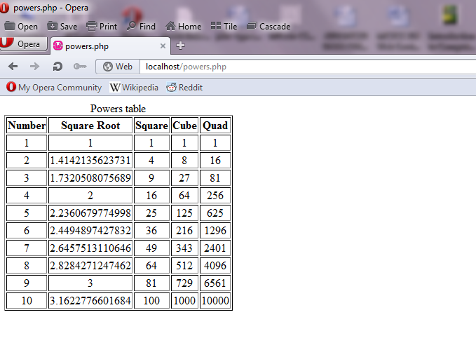
The Output of the program

Slide 23
Arrays
Array are created in PHP in two ways
Assigning a value to an element of an array that does not exists
creates the array
eg. $list[0] = 17;
If empty brackets are used in an assignment to an array a numeric
subscript is implicitly furnished and the furnished subscript is 1
greater than the largest used so far in the array
eg. $list[] = 24
In the above case the subscript value will be 1
The second way to create an array is with the array construct
eg. $list = array(17, 24, 45, 91)

Slide 24
Arrays
PHP supports hash and a hash can be created like
$ages = array(“Joe” => 42, “Mary” => 41, “Bif” => 17);
Individual array elements can be accessed by subscripts
The value in the subscript can be a number or a string
The value of the element whose key is “Mary” in the $ages array can
be set to 29 using the following statement
$ages[‘Mary’] = 29;
Multiple elements of an array can be assigned to scalar variables in
one statement using list construct
$trees = array(“oak”, “pine”, “binary”);
list($hardwood, $softwood, $data_structure) = $trees;

Slide 25
Arrays
In the example $hardwood , $softwood and $data_structure are set to
“oak”, “pine” and “binary” respectively
Individual elements of an array can be removed using unset or even a
whole array can be removed with unset
$list = array(2, 4, 6, 8);
unset($list[2]);
Now the list has three remaining elements with keys 0, 1 and 3 and
elements 2, 4 and 8
The collection of keys and the collection of values of an array can be
extracted with the built in functions array_keys and array_values

Slide 26
Arrays
eg. $highs = array(“Mon” => 74, “Tue” => 70, “Wed” => 67, “Thu” => 62,
“Fri” => 65);
$days = array_keys($highs);
$temps = array_values($highs);
The value of $days is (“Mon”, “Tue”, “Wed”, “Thu”, “Fri”) and the
value of $temps is (74, 70, 67, 62, 65)
The is_array function takes a variable as its parameter and returns
true if the variable is an array else returns false
The in_array function takes two parameters an expression and an
array and returns true if the value of the expression is a value in
the array otherwise false

Slide 27
Arrays
The number of elements in an array can be determined with the
sizeof function
$list = array(“John”, “Anil”, “Alan”, “Sam”);
$len = sizeof($list);
The variable $len will contain the value 4
The explode function explodes a string into substrings and returns
them in an array
$str = “April in Paris, Texas is nice”;
$words = explode(“ “, $str);
$words now contain (“April”, “in”, “Paris,”, “Texas”, “is” “nice”)
The implode function takes an array as input and concatenates the
elements of the array and returns a string

Slide 28
Arrays
$words = array(“Are”, “you”, “going”, “to”, “market”, “today”);
$str = implode(“ ”, $words);
Now $str has “Are you going to market today”
Internally the elements of an array are stored in a linked list of cells
where each cell includes both the key and the value of the element
The cells are stored in memory through a key hashing function so
that they are randomly distributed in a reserved block of storage
Access to elements through string keys are implemented through the
hashing function
The elements have links that connect them in the order in which they
were created which allows them to be accessed in that order
The following figure shows the internal logical structure of an array

Slide 29
Logical internal structure of arrays
This shows how two different access methods can be supported
SequentialAccess Functions
Key Value Next
Current
Key-Based Access Functions
Hash Function
Key Value Next
Key Value Next

Slide 30
Sequential Access to Array Elements
Every array has an internal pointer that refers to one element of the
array called the current pointer
The pointer is initialized to reference the first element of the array at
the time the array is created
The element being referenced by the pointer can be obtained with the
current function
$cities = array (“Delhi ”, “Mumbai”, “Kolkata”, Chennai”);
$city = current($cities);
print (“The first city is $city <br/>”); produces
The first city is Delhi
The current pointer can be moved with the next function that moves
the pointer to the next array element and returns the value

Slide 31
Sequential Access to Array Elements
If the current pointer points to the last element of the array then next
returns FALSE
The following code produces the list of all cities in the array
$city = current($cities);
print(“$city <br/>”);
while ($city = next($cities))
print(“$city <br/>”);
The each function can return a two element array consisting of the
key and the value of the current element
The keys of the two elements of the return value from each are the
strings “keys” and “value”
The following example explains it properly

Slide 32
Sequential Access to Array Elements
$salaries = array(“Mike” => 42500, “Jerry” => 51250, “Fred” => 37920)
while ($employee = each($salaries)) {
$name = $employee[“key”];
$salary = $employee[“value”];
print(“The salary of $name is $salary <br/>”); }
The output produced by this code is
The salary of Mike is 42500
The salary of Jerry is 51250
The salary of Fred is 37920
The current pointer can be moved backward with the prev function
The prev function returns the value of the element referenced by the
current pointer after the pointer has been moved

Slide 33
Sequential Access to Array Elements
The current pointer can be set to the first element with the reset
function which also returns the value of the first element
It can be set to the last element of the array with the end function
which also returns the value of the last element
The key function when given the name of an array returns the key of
the current element of the array
The array_push and array_pop functions provide a simple way to
implement a stack in an array
The foreach statement is designed to build loops that process all of
the elements of an array
The foreach statement has two forms and they are
foreach (array as scalar_variable) loop body

Slide 34
Sequential Access to Array Elements
foreach (array as key => value) loop body
In the first form one of the array values is set to the scalar variable for
each iteration of the loop body
foreach ($list as $temp)
print(“$temp <br/>”);
The code will produce the values of all of the elements of $list
The second form of foreach provides both the key and the value of
each element of the array
$lows = array(“Mon” => 23, “Tue” => 18, “Wed” => 27);
foreach ($lows as $day => $temp)
print(“the low temperature on $day was $temp <br/>”);

Slide 35
Sorting Arrays
The sort function sorts an array with string vales followed by
numeric values in ascending order if the array contains both
string values and numeric values
The asort function is used to sort arrays that correspond to hashes
It sorts the elements of a given array by their values but keeps the
original key-value associations
The elements will be sorted in ascending order where strings
followed by numeric values
The ksort function sorts the given array by keys rather than values
The key-value association is maintained in the process
The rsort, arsort and krsort functions sort elements in the
descending order like their counterparts sort, asort and ksort

Slide 36
A PHP program to sort a hash table
<?xml version = "1.0" encoding = "utf-8"?>
<!DOCTYPE html PUBLIC "-//W3C//DTD XHTML 1.1//EN"
"http://www.w3.org/TR/xhtml11/DTD/xhtml11.dtd">
<!-- sorting.php - An example to illustrate several of the sorting functions -->
<html xmlns="http://www.w3.org/1999/xhtml">
<head>
<title>Sorting</title>
</head>
<body>
<?php

Slide 37
A PHP program to sort a hash table
$original = array("Fred" => 31, "Al" => 27, "Gandalf" => "wizard", "Betty" => 42, "Frodo" => "hobbit");
?>
<h4>Original Array</h4>
<?php
foreach ($original as $key => $value)
print("[$key] = $value <br/>");
$new = $original;
sort($new);
?>
<h4>Array sorted with sort</h4>
<?php

Slide 38
A PHP program to sort a hash table
foreach ($new as $key => $value)
print("[$key] = $value <br/>");
$new = $original;
asort($new);
?>
<h4>Array sorted with asort</h4>
<?php
foreach ($new as $key => $value)
print("[$key] = $value <br/>");
$new = $original;
ksort($new);
?>

Slide 39
A PHP program to sort a hash table
<h4>Array sorted with ksort</h4>
<?php
foreach ($new as $key => $value)
print("[$key] = $value <br/>");
?>
</body>
</html>

Slide 40
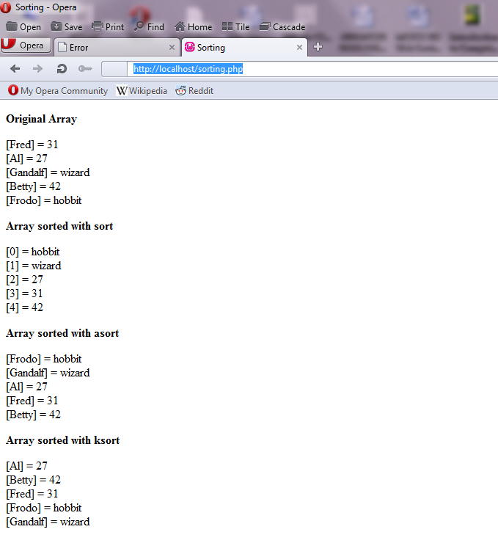
The Output of the program

Slide 41
Functions
PHP supports user defined functions like C Language
The general form of a PHP function is
function name([parameters]) {
…………………. }
The square bracket around the parameters means they are optional
In PHP the function definition does not need to appear in a document
before the function is called
Function overloading is not allowed in PHP
Function names are not case sensitive so a function named sum and
a function named Sum can be used in PHP
The return statement is used to return a value from a function and
will be the last statement in a function

Slide 42
Functions
If one or more related functions are used by more than one document
it is convenient to store their definitions in a separate file and copy
that file into these documents using the include function
Like C in PHP the parameters in the calling program is called actual
parameters and the parameters in the called program is called is
called formal parameters
The default parameter passing mechanism of PHP is pass by value
In parameter passing the values of actual parameters are copied into
the memory locations associated with the corresponding formal
parameters in the called function
The values of the formal parameters are never copied back to the
caller so pass by value implements one way communication

Slide 43
Functions
In the following function the parameters are passed by value
function max_abs($first, $second) {
$first = abs($first);
$second = abs($second);
if ($first >= $second)
return $first;
else
return $second;
}
Parameters that provide two way communication between the caller
and the function can return more than one value

Slide 44
Functions
In two way communication the address of the actual parameter is
passed rather than its value to the function
When the formal parameter is changed in the function it also changes
the corresponding actual parameter and this is called pass by
reference
Pass by reference parameter can be specified in PHP by adding an
ampersand (&) to the beginning of the name of the formal
parameter that must be passed by reference
function set_max(&$max, $first, $second) {
if ($first >= $second)
$max = $first;
else
$max = $second; }

Slide 45
The Scope of Variable
If a variable defined in a function has the same name as a variable in
the main program then there is no interface between the two
A local variable is visible only in the function in which it is used
The same variable can be used in the main program and inside a
function but they have different values or scopes at different
places as shown in the following program
<?xml version = "1.0" encoding = "utf-8"?>
<!DOCTYPE html PUBLIC "-//W3C//DTD XHTML 1.1//EN"
"http://www.w3.org/TR/xhtml11/DTD/xhtml11.dtd">
<!-- sorting.php - An example to illustrate Scope of Varaiable -->
<html xmlns="http://www.w3.org/1999/xhtml">
<head>

Slide 46
The Scope of Variable
<title>Scope of Variable</title>
</head>
<body>
<?php
function summer($list) {
$sum = 0;
foreach ($list as $value)
$sum += $value;
return $sum;
}
$sum = 10;
$nums = array(2, 4, 6, 8);
$ans = summer($nums);

Slide 47
The Scope of Variable
print "The sum of the values in \$nums is: $ans <br/>";
print "The value of \$sum is still: $sum <br/>";
?>
</body>
</html>

Slide 48
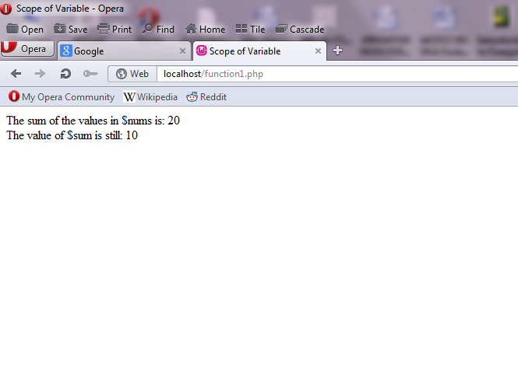
The Output of the program

Slide 49
The Scope of Variable
PHP uses global variables
If a variable is declared as a global variable then it should be declared
outside any function
A global variable has the same meaning inside a function as well as
outside of the function
The following program uses a global variable
<?xml version = "1.0" encoding = "utf-8"?>
<!DOCTYPE html PUBLIC "-//W3C//DTD XHTML 1.1//EN"
"http://www.w3.org/TR/xhtml11/DTD/xhtml11.dtd">
<!-- sorting.php - An example to illustrate Scope of Varaiable -->
<html xmlns="http://www.w3.org/1999/xhtml">
<head>

Slide 50
The Scope of Variable
<title>Scope of Variable</title>
</head>
<body>
<?php
$big_sum = 0;
function summer($list) {
global $big_sum;
$sum = 0;
foreach ($list as $value)
$sum += $value;
$big_sum += $sum;
return $sum;
}

Slide 51
The Scope of Variable
$nums = array(1, 2, 3, 4, 5, 6, 7, 8, 9, 10);
$ans = summer($nums);
print "The sum of all array elements is: $big_sum <br/>";
?>
</body>
</html>

Slide 52
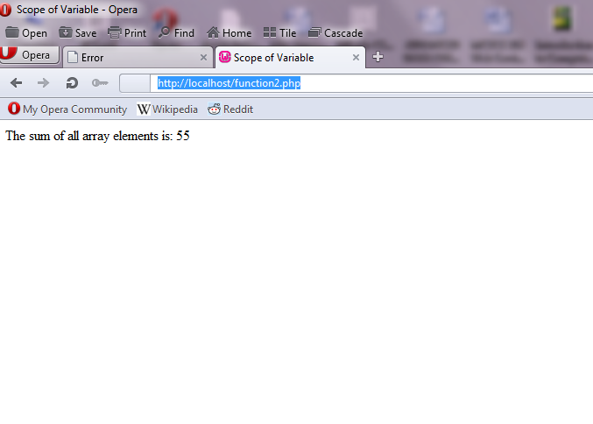
The Output of the program

Slide 53
Pattern Matching
The preg_match is a function in PHP for pattern matching
The preg_match function takes two parameters the first is the regular
expression as a string and the second parameter is the string to
be searched
The preg_split function operates on strings and returns an array
The preg_split function takes two parameters the first is a pattern as
a string and the second parameter is the string to be split
eg. $fruit_string = “apple : orange : banana”;
$fruits = preg_split(“/ : /”, $fruit_string);
then the array $fruits has now (“apple”, “orange”, “banana”)
The following program use preg_split to parse out the words and
produce a frequency of occurrence table

Slide 54
Pattern Matching Program
<?xml version = "1.0" encoding = "utf-8"?>
<!DOCTYPE html PUBLIC "-//W3C//DTD XHTML 1.1//EN"
"http://www.w3.org/TR/xhtml11/DTD/xhtml11.dtd">
<!-- sorting.php - An example to illustrate Scope of Varaiable -->
<html xmlns="http://www.w3.org/1999/xhtml">
<head>
<title>Word Frequency</title>
</head>
<body>
<?php
function splitter($str) {
//Create the empty word frequency array
$freq = array();

Slide 55
Pattern Matching Program
// Split the parameter string into words
$words = preg_split(“ /[.,;:!\?]\s*/", $str);
//Loop to count the words (either increment or initialize to 1)
foreach ($words as $word) {
$keys = array_keys($freq);
if(in_array($word, $keys))
$freq[$word]++;
else
$freq[$word] = 1;
}
return $freq;
}
//Main test driver

Slide 56
Pattern Matching Program
$str = "apples are good for you, or don't you like apples?
or maybe you like oranges better than apples";
//Call splitter
$tbl = splitter($str);
//Display the words and their frequencies
print "<br/> Word Frequency <br/><br/>";
$sorted_keys = array_keys($tbl);
sort($sorted_keys);
foreach ($sorted_keys as $word)
print "$word $tbl[$word] <br/>";
?>
</body>
</html>

Slide 57
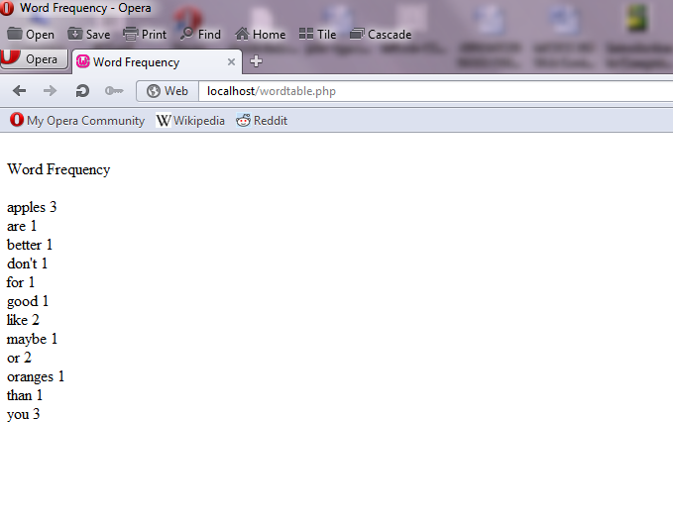
The Output of the program

Slide 58
Files
PHP can be used to create, read and write files on the server system
The first file operation is to open a file and for that a program variable
called file variable is associated with the file for future references
The fopen function is used to open a file and the fopen takes two
parameters the filename and the operation that must be
performed on the file
The fopen function returns the reference to the file
Every open file has an internal pointer called file pointer that is used
to indicate where the next file operation should take place within
the file
File operations can fail due to many reasons like reading a file which
does not exists or file access permission denied

Slide 59
Files
PHP has a built in function called die function which is used to
handle failure of file operations
eg. $file_var = fopen(“testdata.dat”, “r”) or
die (“Error – testdata.dat cannot be opened”);
The die function is executed if the file open process is a failure
A file is closed with the fclose function which takes a file variable as
its only parameter
The functions fread or fgets can be used to read the contents of a file
after opening the file
The fwrite function can be used to write data into a file
The function flock is used to lock a file so that another program
cannot perform a write on a file which is already in use

Slide 60
A PHP program to read a file and display it
<?xml version = "1.0" encoding = "utf-8"?>
<!DOCTYPE html PUBLIC "-//W3C//DTD XHTML 1.1//EN"
"http://www.w3.org/TR/xhtml11/DTD/xhtml11.dtd">
<!-- Filereading.php - Reading a File -->
<html xmlns="http://www.w3.org/1999/xhtml">
<head>
<title>File reading</title>
</head>
<body>
<?php
$handle = fopen("file.txt", "r");
while (!feof($handle)){
$text = fgets($handle);
echo $text, "<BR>“; }
fclose($handle);
?>
</body>
</html>

Slide 61
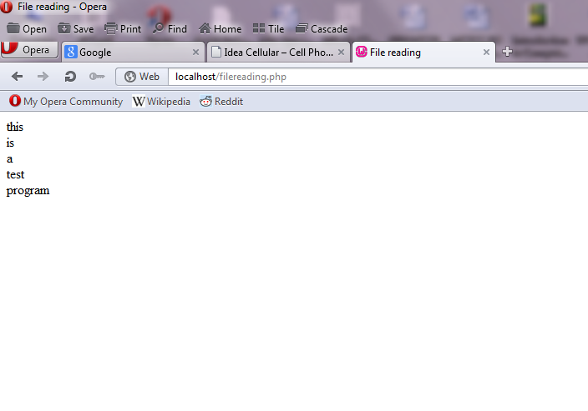
The Output of the program

Slide 62
A PHP program to write to a file
<?xml version = "1.0" encoding = "utf-8"?>
<!DOCTYPE html PUBLIC "-//W3C//DTD XHTML 1.1//EN"
"http://www.w3.org/TR/xhtml11/DTD/xhtml11.dtd">
<!-- Filereading.php - Reading a File -->
<html xmlns="http://www.w3.org/1999/xhtml">
<head>
<title>File reading</title>
</head>
<body>
<?php
$handle = fopen("data.txt", "w");
$text = "A sample PHP file write program“;

Slide 63
A PHP program to write to a file
if (fwrite($handle, $text) == FALSE) {
echo "Can not write data.txt.“;
}
else {
echo "Created data.txt“;
}
fclose($handle);
?>
</body>
</html>

Slide 64
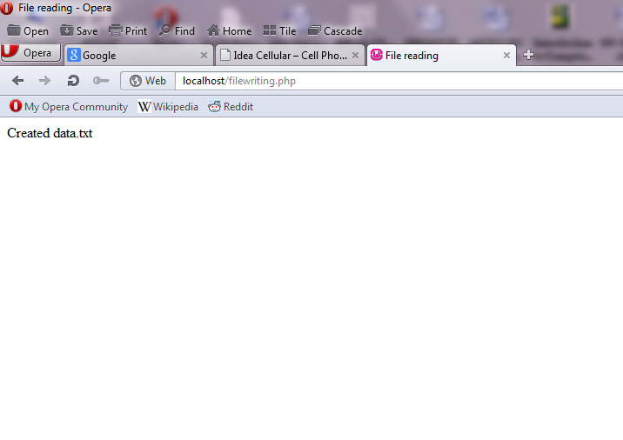
The Output of the program

Slide 65
Form Handling
PHP can be used for Form Handling
The PHP script is embedded in an XHTML document
A form is used to collect information from the user
PHP can be configured so that form data values are directly available
as implicit variables whose names match the names of the
corresponding form elements
PHP uses implicit arrays for form values $_POST and $_GET
These arrays have keys that match the form element names and
values that were input by the client
eg. If a form has a text box named street and the form method is POST
the value of that element is available in the PHP script as
$_POST[“street”]

Slide 66
Form Handling
The form data is used to compute the cost of each product, the total
cost of the order, and the total number of ordered items
The product name, unit price, numbered ordered and total cost for
each product are presented to the client in a table
The table is defined with interwoven XHTML markup and PHP script
The table structure is described with XHTML and the contents of
some data cells are defined with PHP
The printf function is used to implement the numbers that represent
money so exactly two digits appear to the right of the decimal
points

Slide 67
PHP program for form Handling
<?xml version = "1.0" encoding = "utf-8"?>
<!DOCTYPE html PUBLIC "-//W3C//DTD XHTML 1.1//EN"
"http://www.w3.org/TR/xhtml11/DTD/xhtml11.dtd">
<!-- stationary.php - Process the form described in stationary.html -->
<html xmlns="http://www.w3.org/1999/xhtml">
<head>
<title>Process the Stationary.html form</title>
</head>
<body>
<?php
// Get form data values
$book = $_POST["book"];
$pen = $_POST["pen"];

Slide 68
PHP program for form Handling
$pencil = $_POST["pencil"];
$eraser = $_POST["eraser"];
$name = $_POST["name"];
$street = $_POST["street"];
$city = $_POST["city"];
$payment = $_POST["payment"];
// If any of the quantities are blank set them to zero
if ($book == " ") $book = 0;
if ($pen == " ") $pen = 0;
if ($pencil == " ") $pencil = 0;
if ($eraser == " ") $eraser = 0;
//Compute the item costs and total cost
$book_cost = 15.00 * $book;

Slide 69
PHP program for form Handling
$pen_cost = 8.00 * $pen;
$pencil_cost = 3.00 * $pencil;
$eraser_cost = 5.00 * $eraser;
$total_price = $book_cost + $pen_cost + $pencil_cost + $eraser_cost;
$total_items = $book + $pen + $pencil + $eraser;
// Return the results to the browser in a table
?>
<h4>Customer: </h4>
<?php
print ("$name <br/> $street <br/> $city <br/>");
?>
<p/><p/>
<table border = "border“>

Slide 70
PHP program for form Handling
<caption> Order Information </caption>
<tr>
<th> Product </th>
<th> Unit Price </th>
<th> Quantity Ordered </th>
<th> Item Cost </th>
</tr>
<tr align = "center">
<td> Note Book </td>
<td> Rs15.00 </td>
<td> <?php print ("$book"); ?> </td>
<td> <?php printf ("Rs %4.2f", $book_cost); ?> </td>
</tr>

Slide 71
PHP program for form Handling
<tr align = "center">
<td> Ball Pen </td>
<td> Rs8.00 </td>
<td> <?php print ("$pen"); ?> </td>
<td> <?php printf ("Rs %4.2f", $pen_cost); ?> </td>
</tr>
<tr align = "center">
<td> Pencil </td>
<td> Rs3.00 </td>
<td> <?php print ("$pencil"); ?> </td>
<td> <?php printf ("Rs %4.2f", $pencil_cost); ?> </td>
</tr>
<tr align = "center“>

Slide 72
PHP program for form Handling
<td> Eraser </td>
<td> Rs5.00 </td>
<td> <?php print ("$eraser"); ?> </td>
<td> <?php printf ("Rs %4.2f", $eraser_cost); ?> </td>
</tr>
</table>
<p/><p/>
<?php
print "You ordered $total_items items <br/>";
printf ("Your total bill is: Rs %5.2f <br/>", $total_price);
print "Your chosen method of payment is: $payment <br/>";
?>
</body>
</html>

Slide 73
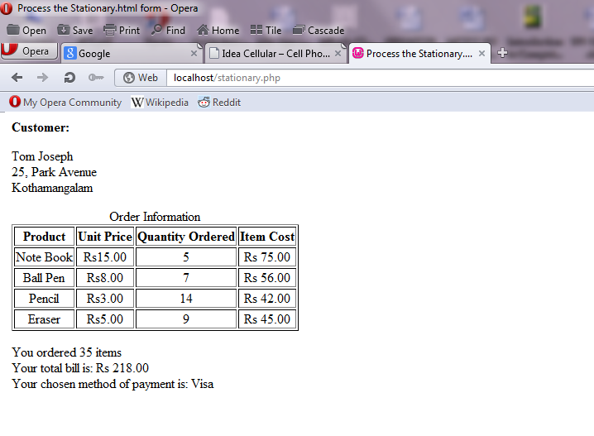
The Output of the program

Slide 74
Cookies
Cookies are set in PHP with the setcookie function
The setcookie function takes three parameters
The first parameter is mandatory and is the cookie’s name
The second parameter is the new value for the cookie
The third parameter is the expiration time in seconds for the cookie
The default value for the expiration time is zero which means the
cookie will be destroyed at the end of the current session
eg. setcookie(“voted”, “true”, time() + 86400);
This creates a cookie named “voted” whose value is “true” and
whose lifetime is one day 86400 seconds
A cookie should be created before any other XHTML tag is executed

Slide 75
Cookies
Cookies are stored in the HTTP header and the HTTP header is sent
before the body of the document is sent
In PHP all cookies that arrive with a request are placed in the implicit
$_COOKIES array which has the cookie name as the key and the
cookie value as value
The following PHP programs set the cookie values and display the
cookie value
<?xml version = "1.0" encoding = "utf-8"?>
<!DOCTYPE html PUBLIC "-//W3C//DTD XHTML 1.1//EN"
"http://www.w3.org/TR/xhtml11/DTD/xhtml11.dtd">
<!-- stationary.php - Process the form described in stationary.html -->
<html xmlns=http://www.w3.org/1999/xhtml>

Slide 76
PHP program to set the cookie values
<head>
<title>Setting a Cookie</title>
<?php
setcookie("message", "No worries", time()+60*60*24*30);
?>
</head>
<body>
<h1>
Setting a Cookie
</h1>
The cookie was set.
<br/>

Slide 77
PHP program to set the cookie values
The expire time is :
<?php $expiretime = time()+60*60*24*30;
echo $expiretime; ?>
seconds
</body>
</html>

Slide 78
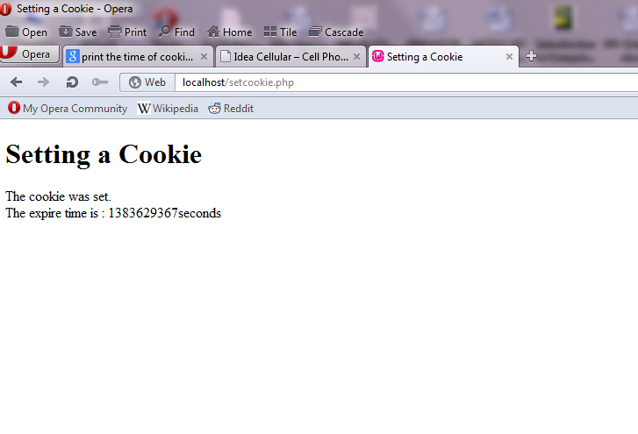
The Output of the program

Slide 79
PHP program to display the value of cookie
?xml version = "1.0" encoding = "utf-8"?>
<!DOCTYPE html PUBLIC "-//W3C//DTD XHTML 1.1//EN"
"http://www.w3.org/TR/xhtml11/DTD/xhtml11.dtd">
<!-- stationary.php - Process the form described in stationary.html -->
<html xmlns="http://www.w3.org/1999/xhtml">
<head>
<title>Reading a Cookie</title>
</head>
<body>
<h1>
Reading a Cookie
</h1>

Slide 80
PHP program to display the value of cookie
The cookie says:
<?php
if (isset($_COOKIE['message'])) {
echo $_COOKIE['message'];
}
?>
</body>
</html>

Slide 81
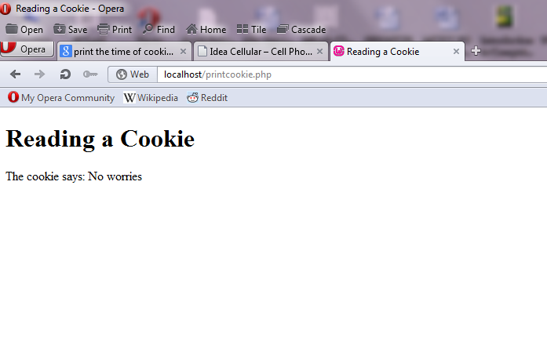
The Output of the program

Slide 82
Session Tracking
In many cases like shopping cart the information about a session is
to be stored for the next session
The information about a session can be identified by a unique
identifier and is named session tracking
A single session array can be used to store information about the
previous requests of a client during a session
Session arrays store a unique session ID for a session
Session arrays are stored in the server whereas cookies are stored in
the client machine
In PHP a session_start function is used to start a session which
causes a session ID to be created and recorded

Slide 83
Session Tracking
On subsequent calls to session_start in the same session the
function retrieves the $_SESSION array which stores any session
variables and their values that was registered in the previous
session
Session key/value pairs are created or changed by assignments to
the $_SESSION array
The session details can be destroyed with the unset operator
The following programs stores data in the session array and retrieves
data from the session array later

Slide 84
PHP program to set the session array
<?xml version = "1.0" encoding = "utf-8"?>
<!DOCTYPE html PUBLIC "-//W3C//DTD XHTML 1.1//EN"
"http://www.w3.org/TR/xhtml11/DTD/xhtml11.dtd">
<!-- stationary.php - Process the form described in stationary.html -->
<html xmlns="http://www.w3.org/1999/xhtml">
<head>
<title>Storing data in sessions</title>
</head>
<body>
<h1>
Storing data in sessions
</h1>

Slide 85
PHP program to set the session array
<?php
session_start();
$_SESSION['purchase'] = "39.25";
?>
Stored the purchase Rs 39.25.
</body>
</html>

Slide 86
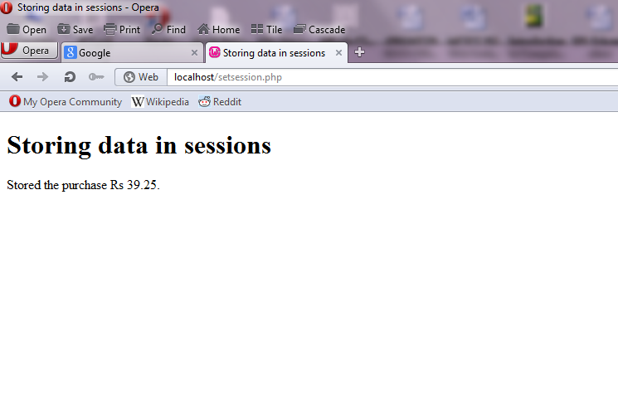
The Output of the program

Slide 87
PHP program to retrieve data from the session array
<?xml version = "1.0" encoding = "utf-8"?>
<!DOCTYPE html PUBLIC "-//W3C//DTD XHTML 1.1//EN"
"http://www.w3.org/TR/xhtml11/DTD/xhtml11.dtd">
<!-- stationary.php - Process the form described in stationary.html -->
<html xmlns="http://www.w3.org/1999/xhtml">
<head>
<title>Retrieving data from sessions</title>
</head>
<body>
<h1>
Retrieving data from sessions
</h1>
The data from the session array is :

Slide 88
PHP program to retrieve data from the session array
<?php
session_start();
if(isset($_SESSION["purchase"])){
echo $_SESSION['purchase'];
}
?>
</body>
</html>

Slide 89
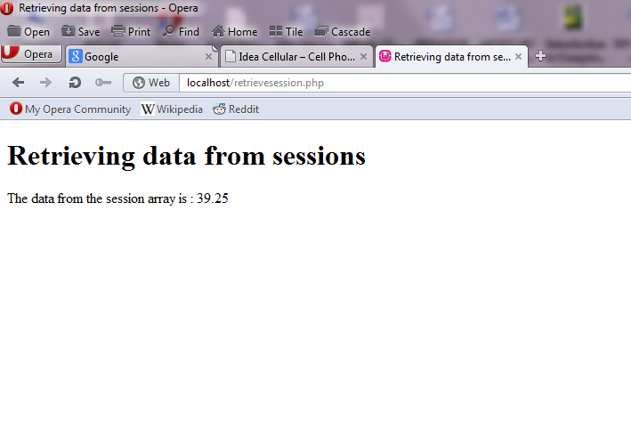
The Output of the program

